Slide 1

JCAPS 5.1 Email Send POC
Phani Krishna

Slide 2
Email Send Scenario
Components Required
  Connectivity Map
  Java Collaboration
  Deployment Profile
  External Systems

Slide 3
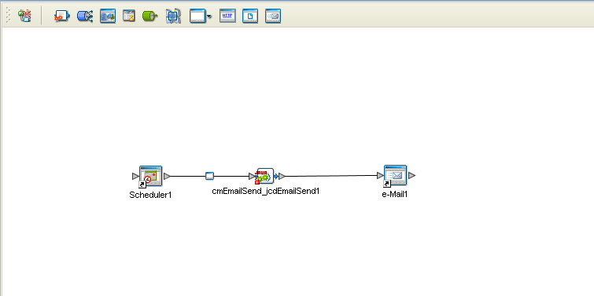
Connectivity Map

Slide 4
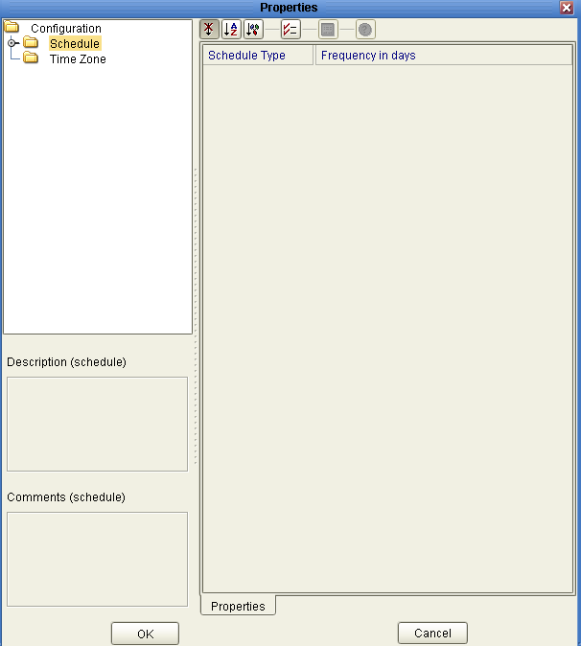
Inbound Scheduler Parameter Settings
( Scheduler1 -> cmEmailSend_jcdEmailSend1)

Slide 5
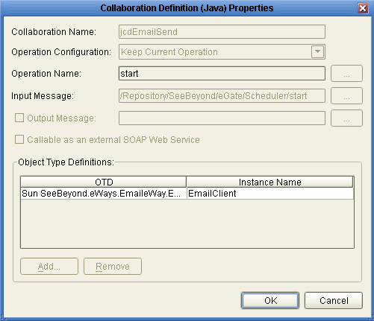
Java Collaboration
(jcdEmailSend)

Slide 6
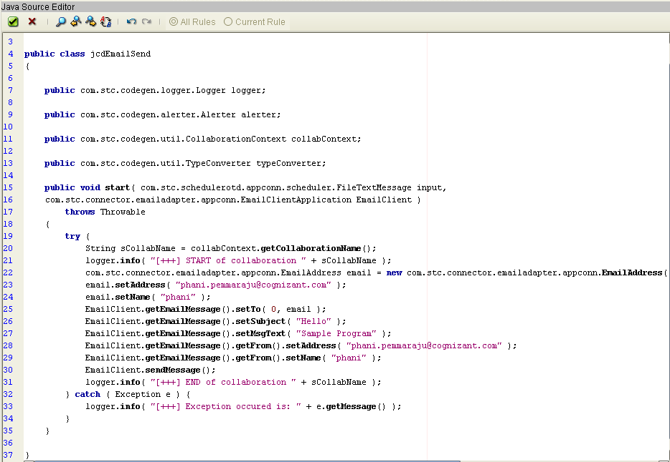
Jcd Code
(jcdEmailSend)

Slide 7
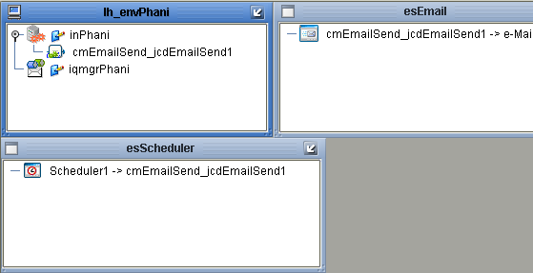
Deployment Profile
(dpFileToFile)

Slide 8
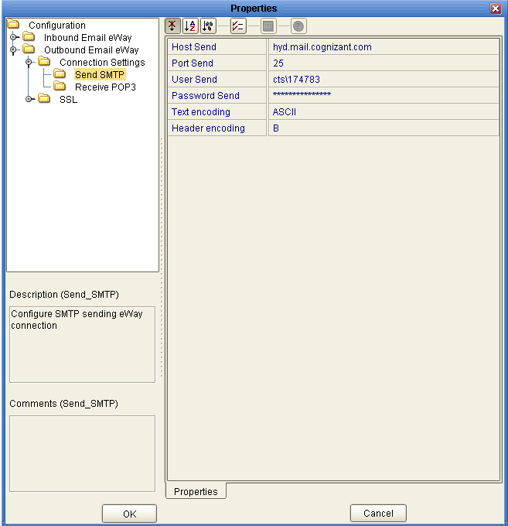
External System - esEmail

Slide 9
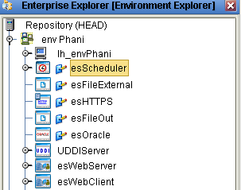
External System - esScheduler

Slide 10
Thank You
Phani Krishna

